Slide 1
Portfolio Milestone
Waylon Abernathy
SUID: 330621920
Email: waylonabernathy@gmail.com, wabernat@syr.edu
GitHub repository: https://github.com/wabernathy3/Portfolio-Milestone

Slide 2
Overview of Practice Areas
Data Collection
Data collecting
Data cleaning
Data organization
Data Exploration
Visual
Statistical
Data Analysis
Insight
Trends and Patterns
Implementation
Business Decisions
AI
Machine Learning
Predictive Modeling

Slide 3
Collect and Organize Data
Zip code Analysis
Basketball MVP
Ultra Runner database
Notes:
3 different projects to illustrate
Collecting and Organizing data essential to answer questions with data
Incorrect and/or incomplete data leads to inaccurate results
Foundation of data science

Slide 4
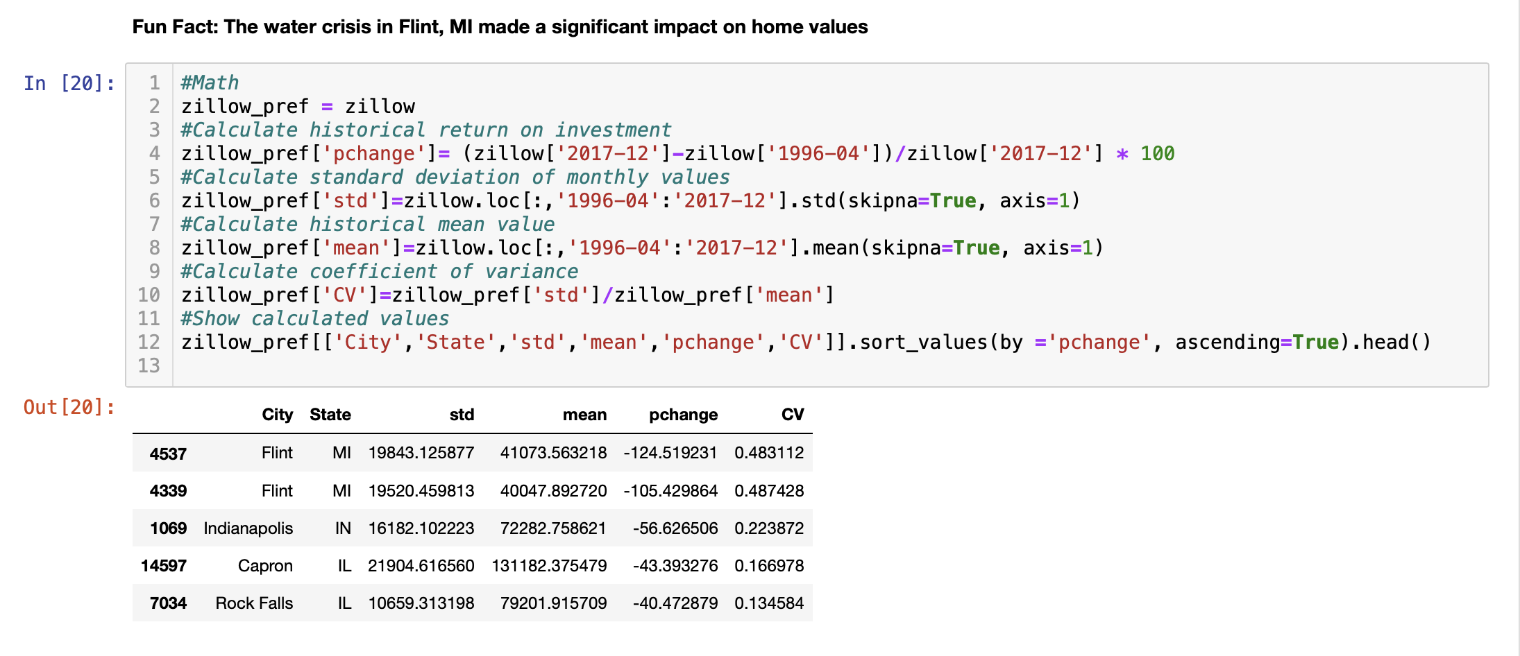
Zip code Analysis IST 718
Creating percent change
Add additional datasets for filtering
Wallethub best places to live in the US data
Notes:
Dataset for every US zip code with average home value from 96-2017
Needed to manipulate data to find percent change in home values for proper analysis
Added in Wallethub data to help filter down the zip codes
This helped limit and narrow scope to choose 3 zip codes for investment / place to live

Slide 5
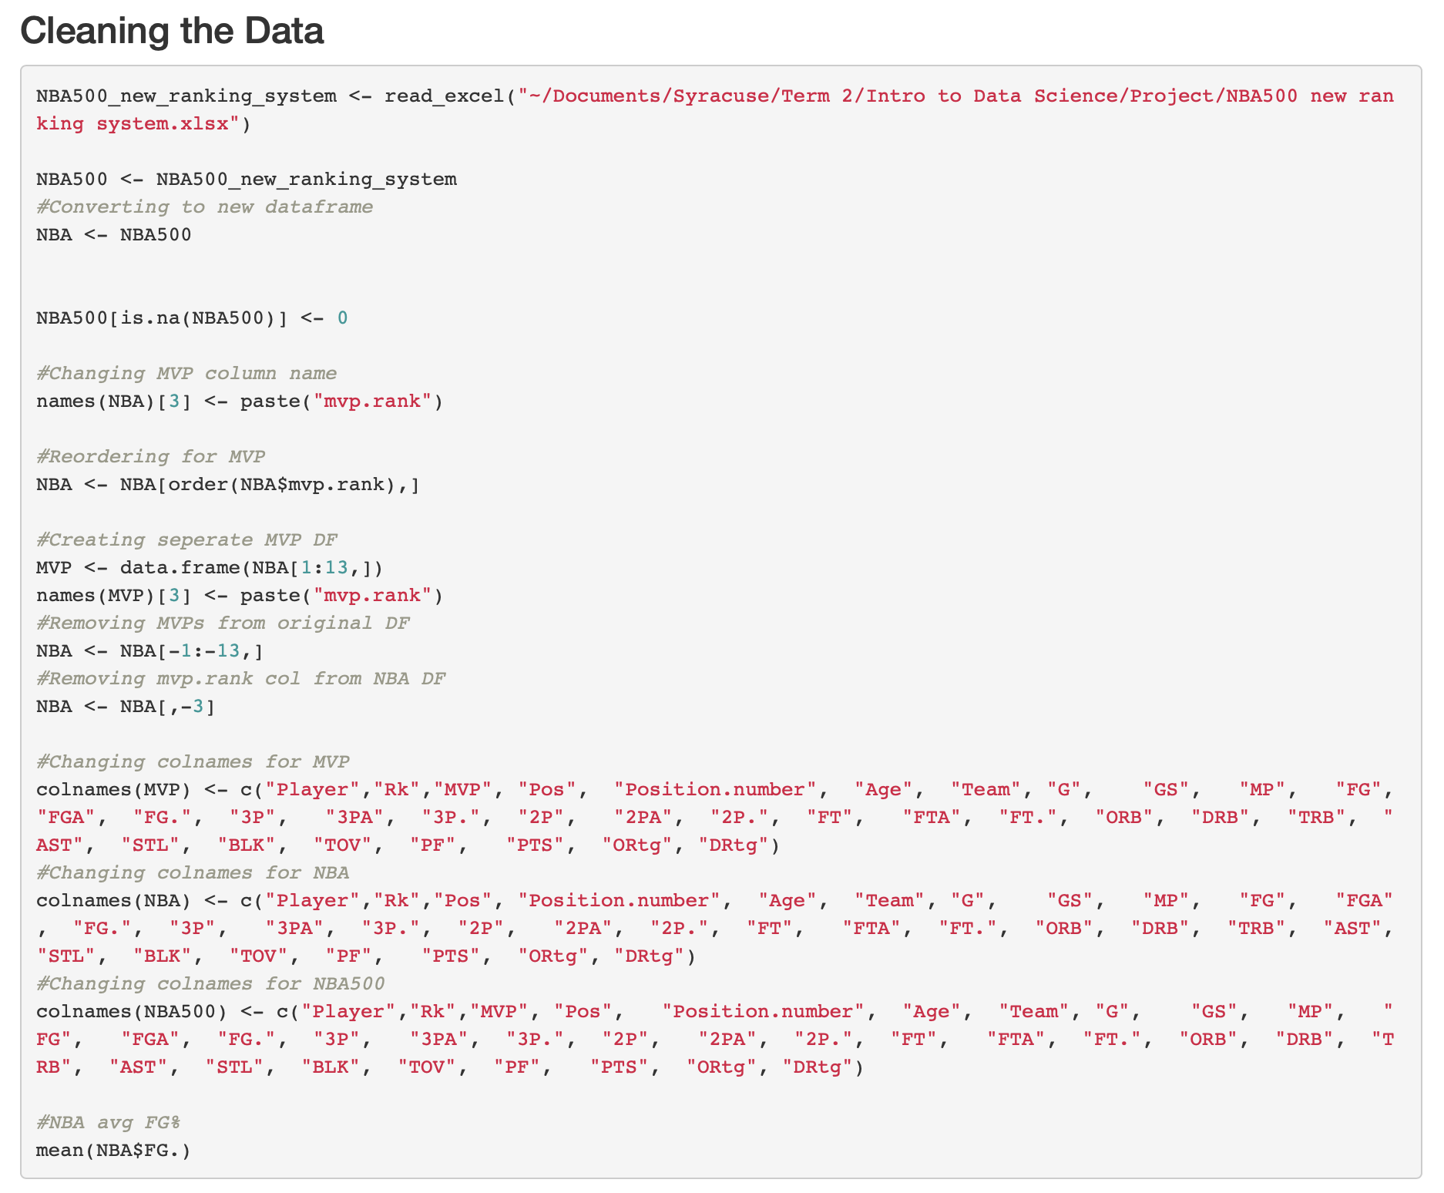
Basketball MVP IST 687
Using basketball statistics to find how and why players receive MVP votes
Pulled data from basketball reference website for statistics
Added in number of votes received to data for analysis
Was able to discover that player position (power forward) and specific stats can greatly determine number of votes
Minutes Played
Offensive Rating
Games Started and Played
Field Goal Attempts
Helps to be a ball hog
Notes:
Used filtering to help understand what basketball statistics increase chances of gathering MVP votes
Importance of getting correct data; otherwise, the entire project would have been inaccurate

Slide 6
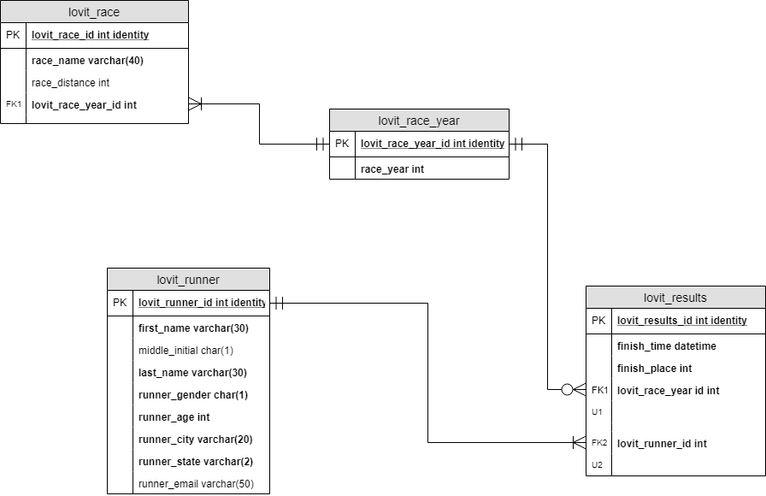
Ultra Runner Database IST 659
Created SQL database for the LOVIT 100-mile ultra race results
Learned to create database and SQL coding skills by entering every participant by every year manually
Worked with Professor Harper to create SQL work-around to enter finish times longer than 24-hours
Notes:
Learned how to SQL code
Importance for accuracy in coding to provide correct results
Created database of 3 years worth of race results

Slide 7
Identify Patterns in Data
Zip code Analysis
Coach Analysis
Basketball MVP
Notes:
Important to understand what the data can be used for
Can help gain quick knowledge about given dataset
Helps narrow scope
Can help answer questions but can also raise additional questions

Slide 8
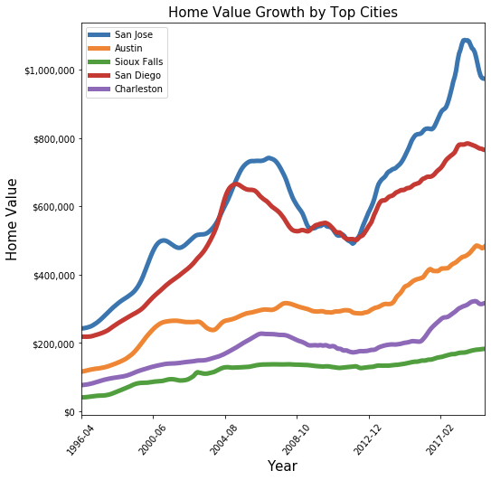
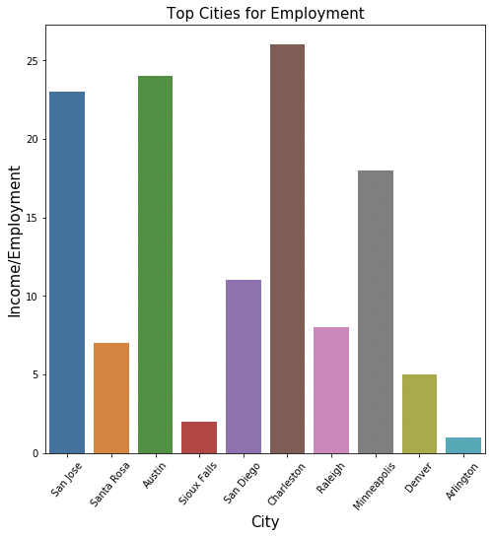
Zip Code Analysis IST 718
Using data visualization to narrow scope
Able to quickly interpret what cities were insulated from 2008-2009 financial crash
Bar chart to visualize top ranked cities for employment opportunity
Notes:
Dataset of every US zip code with average home value from 1996 – 2017

Slide 9
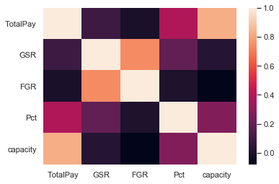
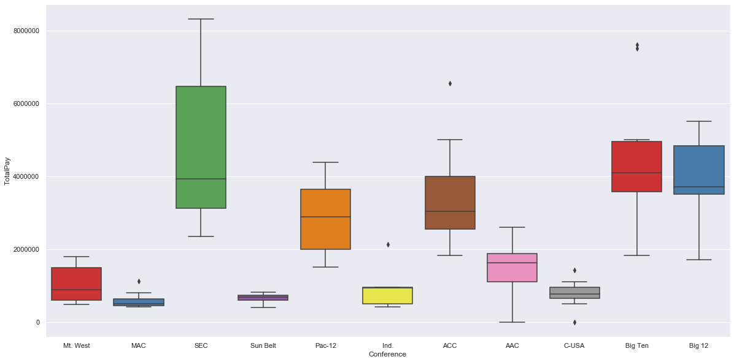
Coach Analysis IST 718
Using visuals to inform data analysis and exploration
Box plot to visualize pay by conference
Heatmap to explore important variables for future data analysis/predicting salary

Slide 10
Basketball MVP IST 687
Visuals to tell a story
How MVP’s get votes based on statistics and what statistics matter in basketball

Slide 11
Develop Alternative Strategy based on Data Develop Plan of Action to Implement Business Decision
Mental Health Analysis
Notes:
After identifying patterns, the patterns may lead the project in new, interesting direction
This project utilized survey’s regarding mental health in the IT field
Original goal to try to use predictive analysis to identify variables of those at-risk for mental illness
Goal changed with the data exploration

Slide 12
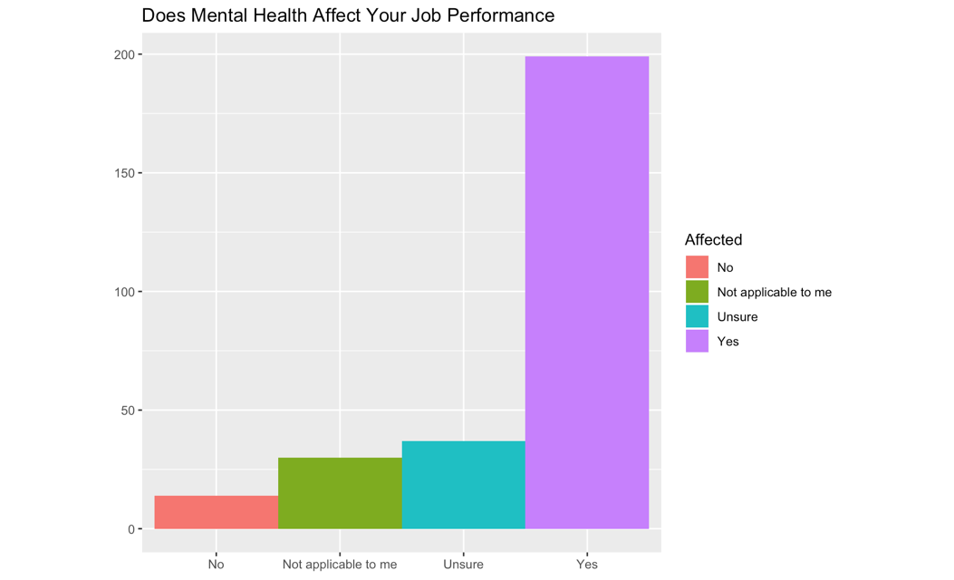
Mental Health Analysis IST 707
Association Rule Analysis Summary: (top three models)
lhs | rhs | Support | Confidence | Lift
anonymity=no, MH. Consequence=yes, age=twenties | supervisor=No | 0.0112 | 1.0000 | 4.2648
coworkers=no, anonymity=yes, MH. Consequence=yes | supervisor=No | 0.0167 | 0.9600 | 4.0942
wellness.program=no, coworker=no,MH.consequence=no | supervisor=No | 0.1221 | 0.7028 | 2.9974
coworker=no, MH.hurt.career=’yes, I think it would’ | supervisor=No | 0.1172 | 0.7058 | 3.0105
anonymity=no, MH.consequence=yes | supervisor=No | 0.2023 | 0.8055 | 3.4355
anonymity=no, exp.neg.reponse=’yes, I observed’ | supervisor=No | 0.0105 | 0.7143 | 3.0463
Data Exploration led to change in direction of project
Found Mental Health Can Affect Job
Narrowed focus on barriers for seeking help vs predicting variables to identify at-risk for mental illness
Notes:
Found that mental illness can affect job performance which led to change in project strategy
Pivoted project to understand how business could improve job performance by way of addressing mental health in coworkers
Found patterns that created barriers in getting help

Slide 13
Mental Health Anaysis
Plan of Action to implement business decisions
Found that individual and business may benefit from proactively seeking help
Mental Illness drives down job performance
Happy coworkers = higher level of production
Work environment plays strong role in seeking help
Notes:
Project utilized basket analysis and decision tree to better understand what was preventing co-workers from seeking help for mental illness
Can sell idea to business by showing job performance would likely improve when mental illness is addressed

Slide 14
Communication Skills with Data
Data Analysis & Decision-Making Storyboard
Mental Health Project
Notes:
Two examples of different types of communication
Business communication
Mental Health Project – Academic communication

Slide 15
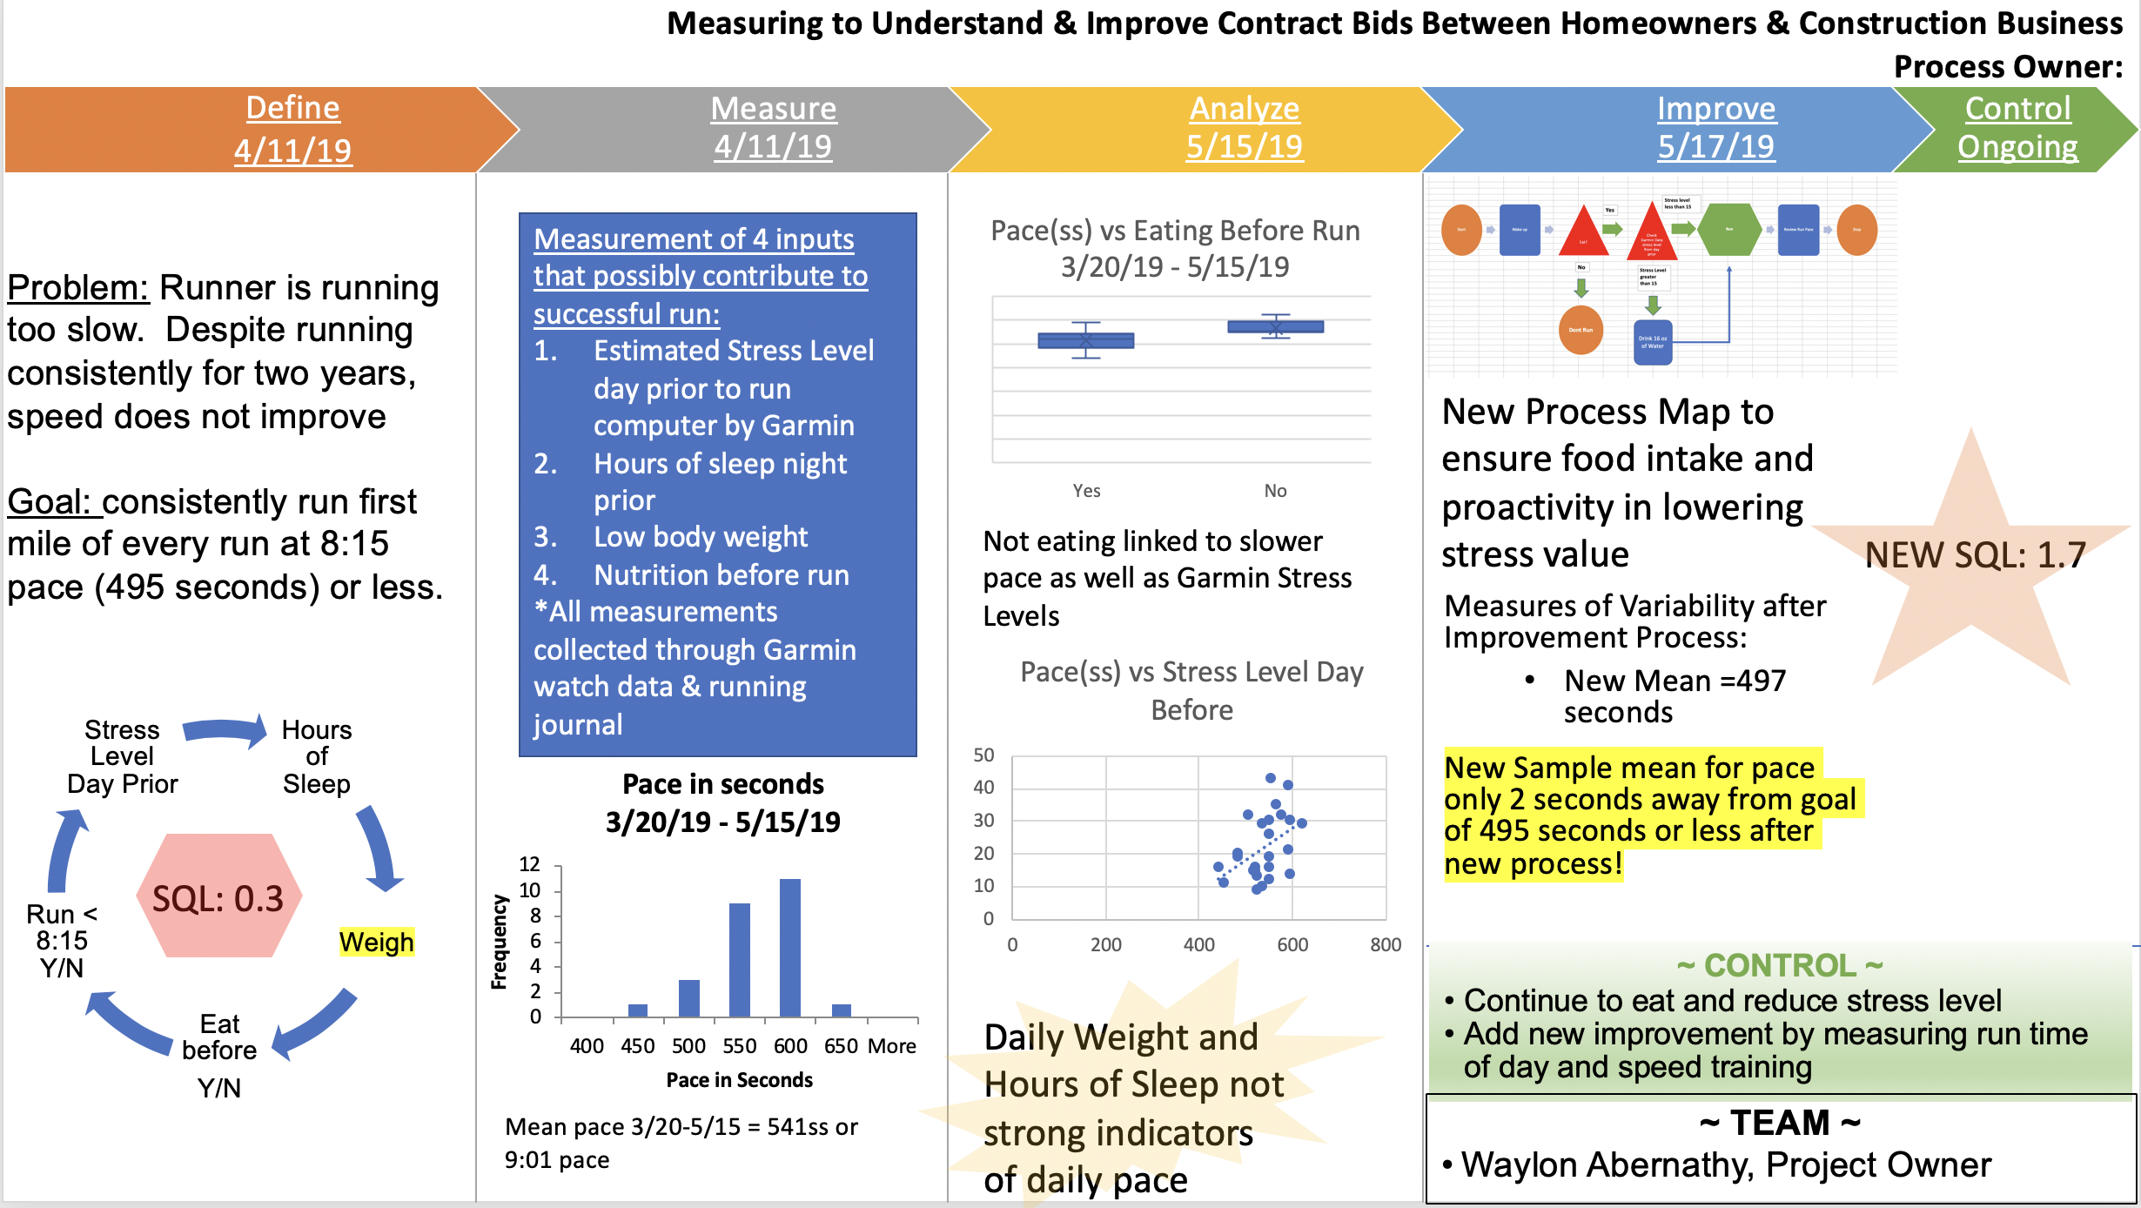
Data Analysis and Decision-Making Project MBC 638
Use of Storyboard to quickly deliver overall message of the project
Use of PowerPoint to dig into the details
Notes:
Use of storyboard to open with PowerPoint helps deliver overall message of project and what was improved
Building upon storyboard, PowerPoint gives opportunity to get into the weeds of the project

Slide 16
Mental Health Analysis IST 707
Academic-style paper
Learned proper formatting and style for writing academic papers
Link to GitHub for paper
Mental Health Project – Data Analysis
Notes:
Group project with Brian Hogan taught me what goes into creating a proper academic-style paper

Slide 17

Synthesize Ethical Dimensions of Data Science Practice
Privacy and the Public in the Technological Age
IST 618: Privacy and the Public in the Technological Age – Information Policy
NSA’s use of the program PRISM
Questionable ethics related to private communications of the public and public data
Mental Health Project
Potential to use mental health questionnaire to understand variables and predict those at-risk for mental illness
May create bias when hiring
California’s privacy laws to protect ownership of data
Notes:
Information Policy was great at opening eyes to different issues related to data, privacy, and philosophy
Future of driving cars, AI
Algorithm bias in big data
Need for ethics committee/governing body in data science

